Slide 1
Google Colab使用手冊 使用Google Colab學習Python與人工智慧

Slide 2
本課程目的:
使用Google Colab平台學習Python程式設計
使用Google Colab平台學習Python資料分析技術
使用Google Colab平台學習機器學習(machine Learning)
使用Google Colab平台學習深度學習(deep Learning)
使用Google Colab平台學習強化學習(reinforcement Learning)

Slide 3
課程內容
開始使用google colab學習
登入與使用Google Colab
認識Google Colab給你的VM
上傳你的pyhon程式(XXX.py)並執行
上傳圖片並執行Python程式分析
上傳csv檔案並執行python程式分析 downloading, reading and displaying .csv file
Download a file to local computer
Setting Free GPU
Access your Google Drive filesystem
安裝PyTorch

Slide 4
參考資料
https://medium.com/deep-learning-turkey/google-colab-free-gpu-tutorial-e113627b9f5d
https://www.kdnuggets.com/2019/01/more-google-colab-environment-management-tips.html
3 Essential Google Colaboratory Tips & Tricks
https://www.kdnuggets.com/2018/02/essential-google-colaboratory-tips-tricks.html

Slide 5
Google Colab

Slide 6

Google Colab平台
Google Colab is a free cloud service and now it supports free GPU!
You can;
improve your Python programming language coding skills.
develop deep learning applications using popular libraries such as Keras, TensorFlow, PyTorch, OpenAI gymand OpenCV.
The most important feature that distinguishes Colab from other free cloud services is; Colab provides GPU and is totally free.

Slide 7
登入與使用
Google Colab

Slide 8
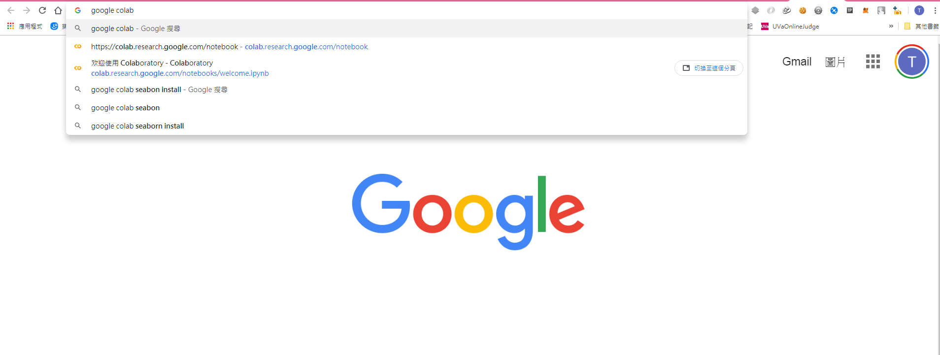
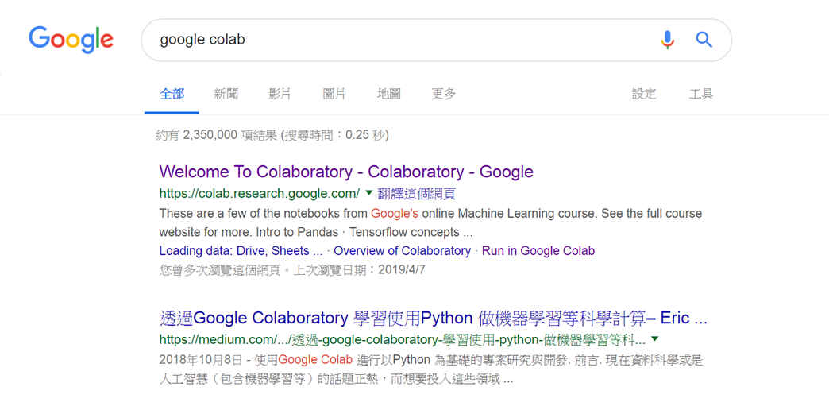
從Google首頁搜尋Google colab
點選

Slide 9
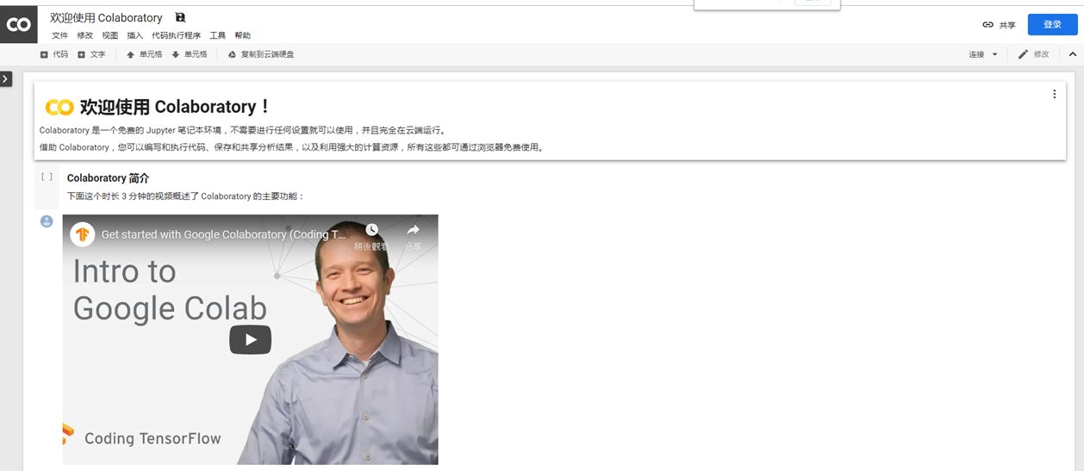
Google colab的首頁

Slide 10
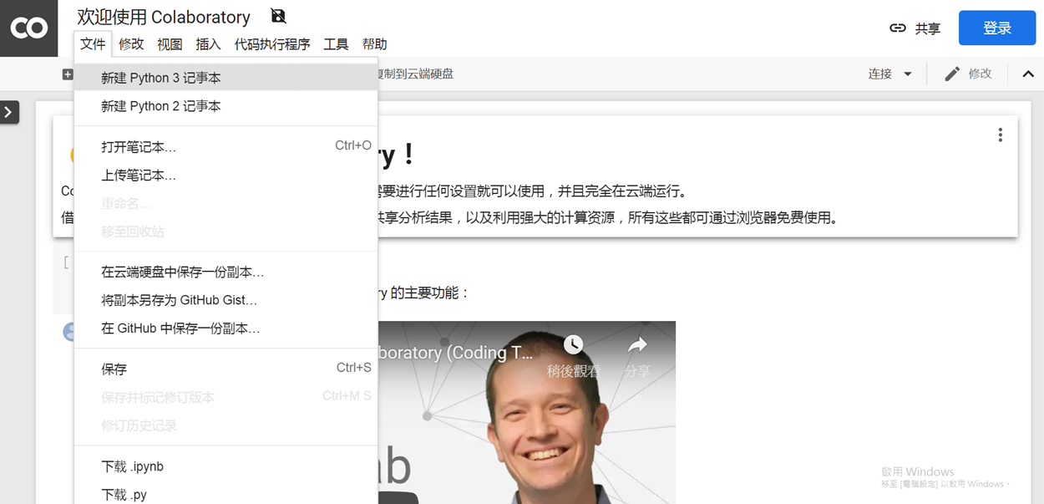
點選文件 從下拉式選單選取新建Python3記事本

Slide 11
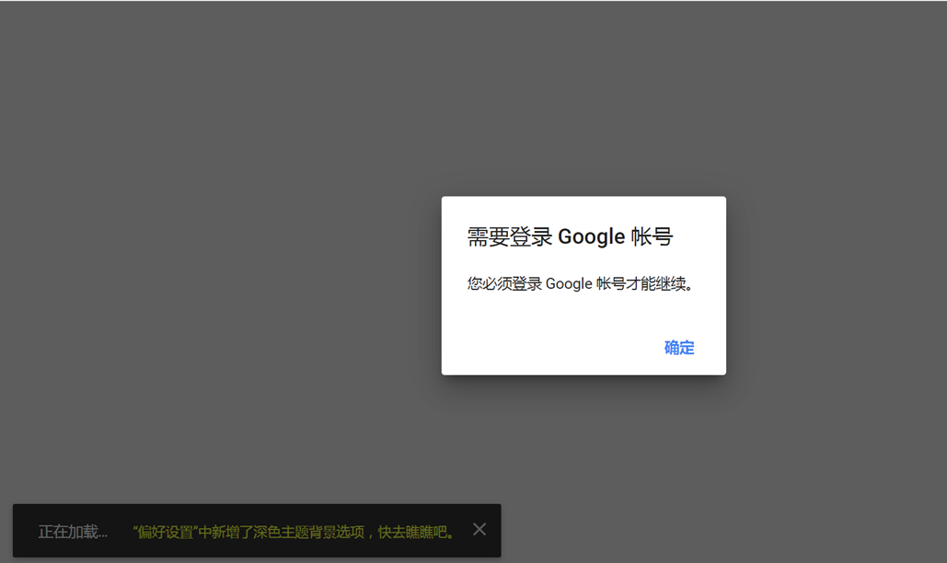
Google colab要求使用Google帳號登入 按確認後使用Google帳號登入即可使用
點選

Slide 12
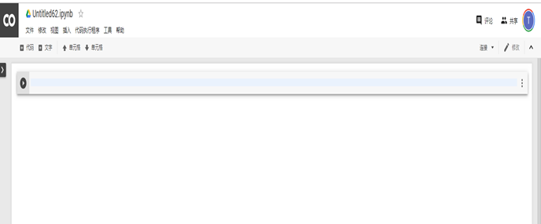
登入後畫面如下 接著開始寫程式
點選後開始寫程式

Slide 13
# coding: utf-8
import numpy as np
def AND(x1, x2):
x = np.array([x1, x2])
w = np.array([0.5, 0.5])
b = -0.7
tmp = np.sum(w*x) + b
if tmp <= 0:
return 0
else:
return 1
if __name__ == '__main__':
for xs in [(0, 0), (1, 0), (0, 1), (1, 1)]:
y = AND(xs[0], xs[1])
print(str(xs) + " -> " + str(y))

Slide 14
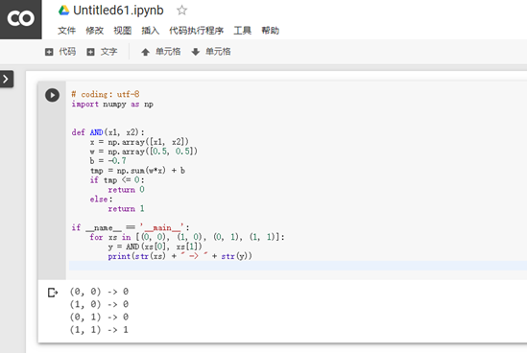
輸入你寫的程式 點選後即可執行
點選

Slide 15
執行結果

Slide 16
認識
Google Colab
給你的VM

Slide 17
 | !ls
 | !cat /proc/meminfo
 | !cat /proc/cpuinfo
Is GPU Working? | import tensorflow as tf tf.test.gpu_device_name()
Which GPU Am I Using? | from tensorflow.python.client import device_lib device_lib.list_local_devices()
 | !pip list
Restart Google Colab | !kill -9 -1

Slide 18
確認套件版本
Python 3
import pandas as pd
print(“pandas version: %s” % pd.__version__)
import matplotlib
print("matplotlib version: %s" % matplotlib.__version__)
import numpy as np
print("numpy version: %s" % np.__version__)
import sklearn
print("scikit-learn version: %s" % sklearn.__version__)

Slide 19
NEXT
上傳圖片並執行python程式分析

Slide 20
NEXT
上傳csv檔案並執行python程式分析

Slide 21
from google.colab import files
uploaded = files.upload()

Slide 22
NEXT
Download a file to local computer

Slide 23
Download a file to local computer
This is another simple one, but important enough to mention. A use case: you have created a Keras model and want to visualize the model. You call plot_model to create a PNG file, but since Colab virtual machines don't give you permanency in file storage, you want to download the image. The following excerpt does it:
# plot model
plot_model(model, to_file='rnn-mnist.png', show_shapes=True)
# download model image file
from google.colab import files
files.download('rnn-mnist.png')

Slide 24
Display an image inline
Yeah, it's elementary, but it took me a few to remember that I was working with more or less a regular Jupyter environment with Colab. So, to display the above image inline, use:
# display model image file inline
from IPython.display import Image, display
Image('rnn-mnist.png')

Slide 25




執行大大分享的python程式(xxx.ipynb)
Google Colab平台
執行你已開發的python程式(xxx.ipynb)
將你開發的python程式(xxx.ipynb)存到
github做備份
執行你存在google drive的python程式(xxx.ipynb)
Google 雲端硬碟

Slide 26
NEXT
上傳你的pyhon程式並執行

Slide 27
Access your Google Drive filesystem
# save model image file to Google Drive
from google.colab import drive
drive.mount('/content/gdrive')
!ls -la /content/gdrive/My\ Drive/Colab\ Notebooks/
# import pandas as pd
titanic_train = pd.read_csv('/content/gdrive/My Drive/Colab Notebooks/datasets/titanic/train_clean.csv')

Slide 28
3. Use custom libraries and modules stored in Google Drive
import sys
sys.path.insert(0, '/content/gdrive/My Drive/Colab Notebooks/my_modules')
import naive_sharding
That's it; the naive_sharding.py module has been imported, and is ready to use.

Slide 29
import tensorflow as tf
device_name = tf.test.gpu_device_name()
if device_name != '/device:GPU:0':
raise SystemError('GPU device not found')
print('Found GPU at: {}'.format(device_name))

Slide 30
3. Uploading and Using Data Files
from google.colab import files
uploaded = files.upload()
for fn in uploaded.keys():
print('User uploaded file "{name}" with length {length} bytes'.format(name=fn, length=len(uploaded[fn])))
import pandas as pd
import io
df = pd.read_csv(io.StringIO(uploaded['iris.csv'].decode('utf-8')))
print(df)
from google.colab import files
files.download("births.csv")

Slide 31
本次主題:
執行你存在google drive的python程式(xxx.ipynb)
Google Colab平台
Google 雲端硬碟
我的程式碼:
https://github.com/MyDearGreatTeacher/AI_and_security/blob/master/%E5%9F%B7%E8%A1%8CGoogle_drive%E7%9A%84Python%E7%A8%8B%E5%BC%8F(XXX_py).ipynb

Slide 32
設定權限
from google.colab import drive
drive.mount('/content/drive/')

Slide 33
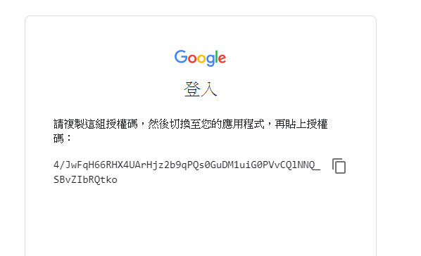
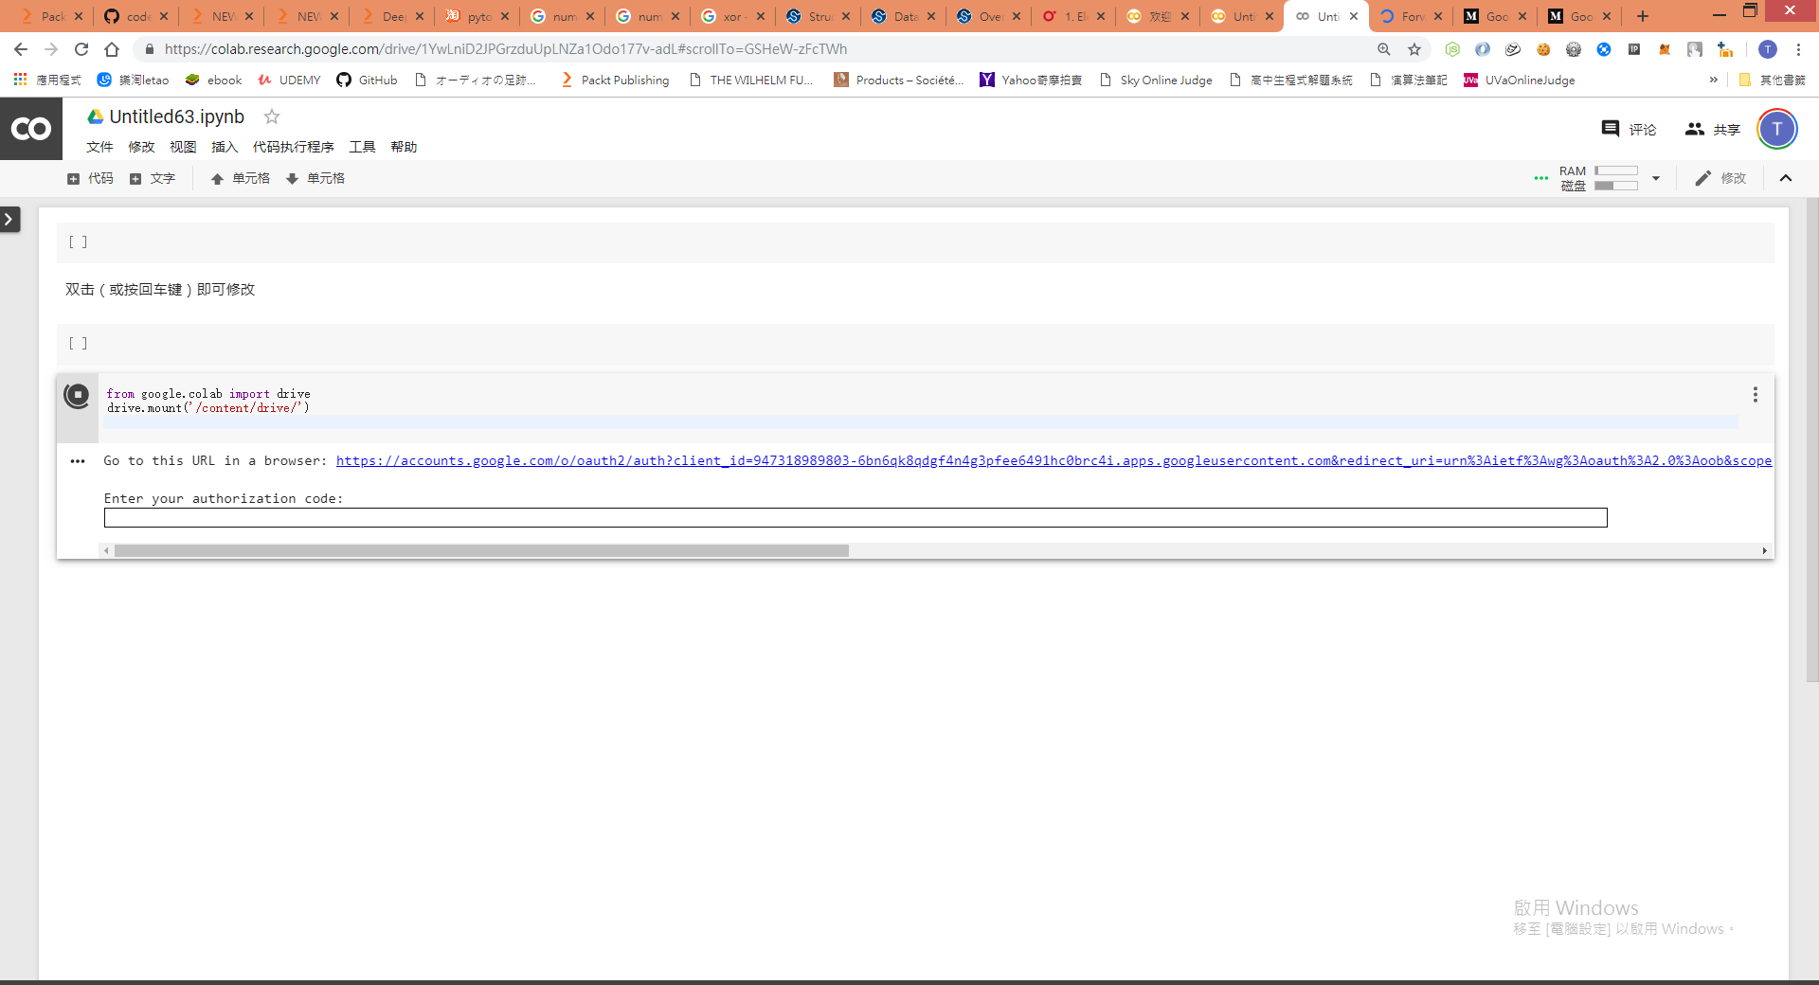

Slide 34
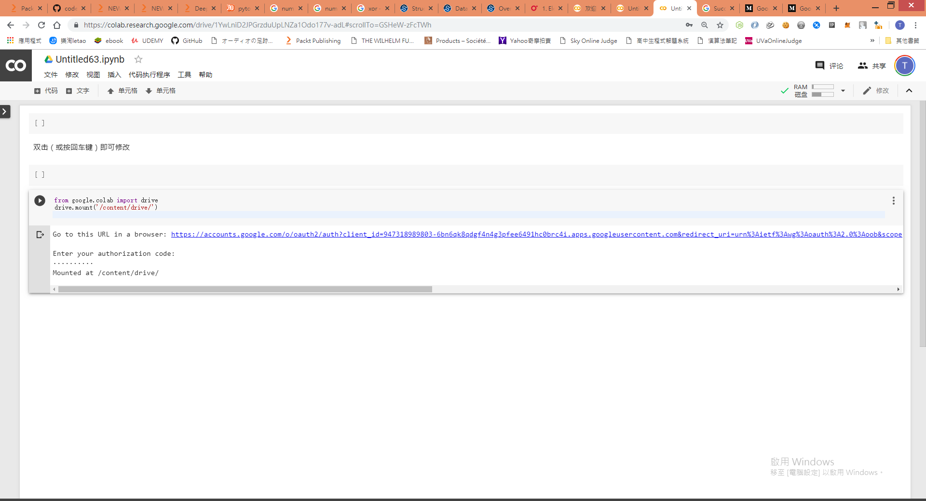

Slide 35
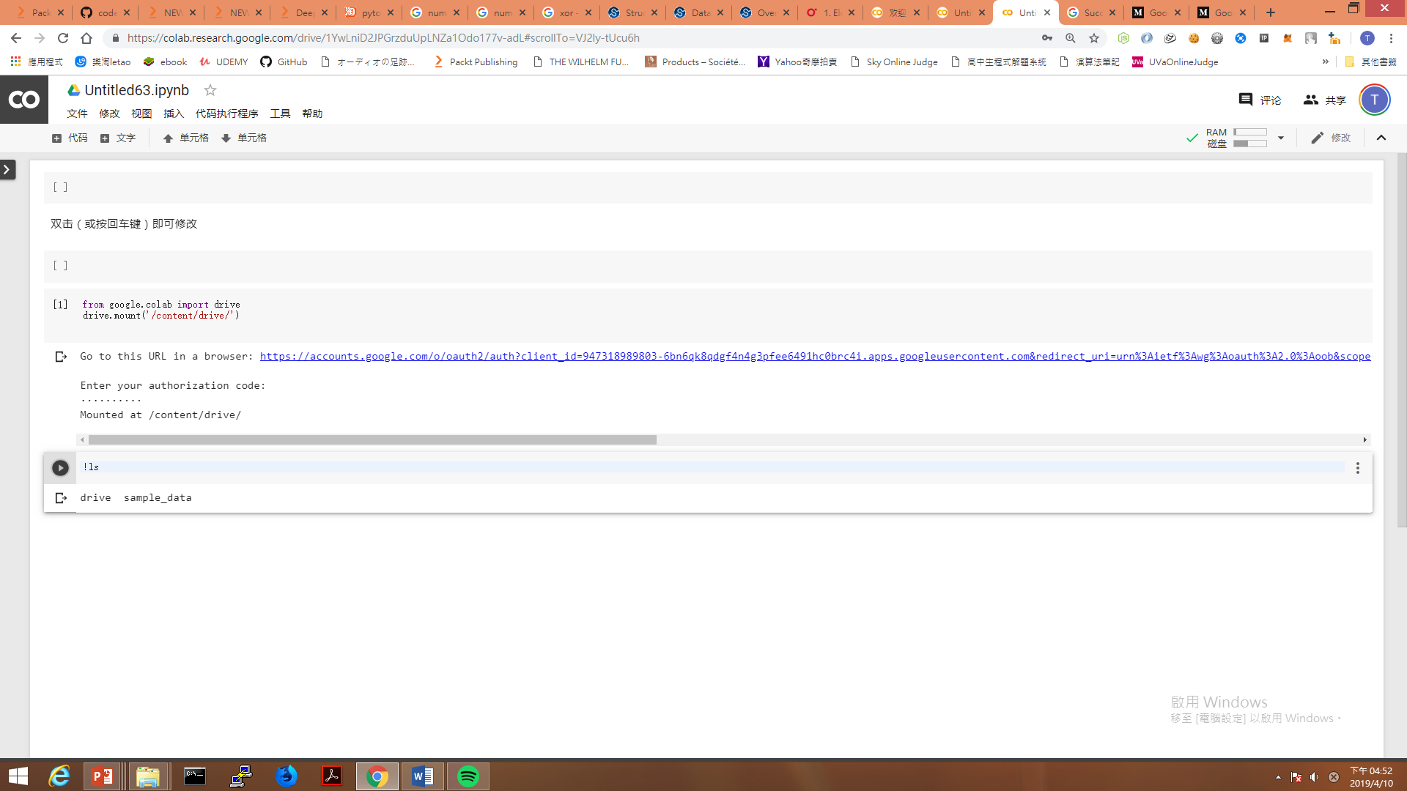

Slide 36
檢視你雲端硬碟上的資料
!ls "/content/drive/My Drive/"
!ls "/content/drive/My Drive/Colab Notebooks"
!ls "/content/drive/My Drive/PythonCode"

Slide 37
執行你雲端硬碟上的pythont程式
要先在你的google drive建立目錄並上傳你的pythont程式
!python3 "/content/drive/My Drive/PythonCode/mnist_cnn.py"

Slide 38
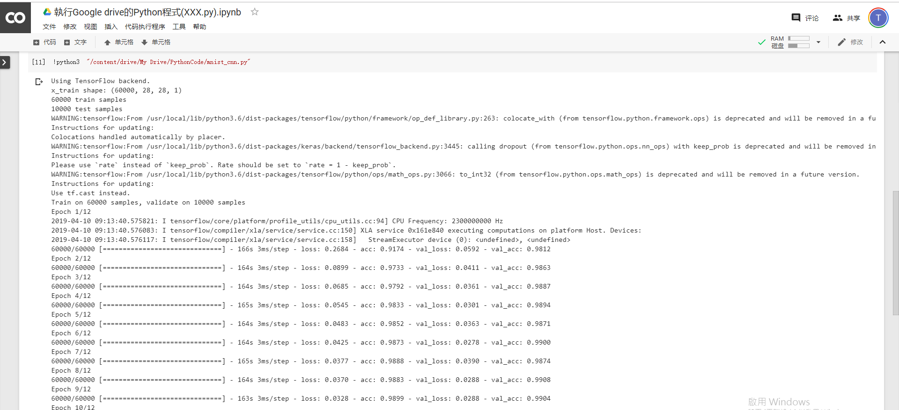
跑了好久………………

Slide 39
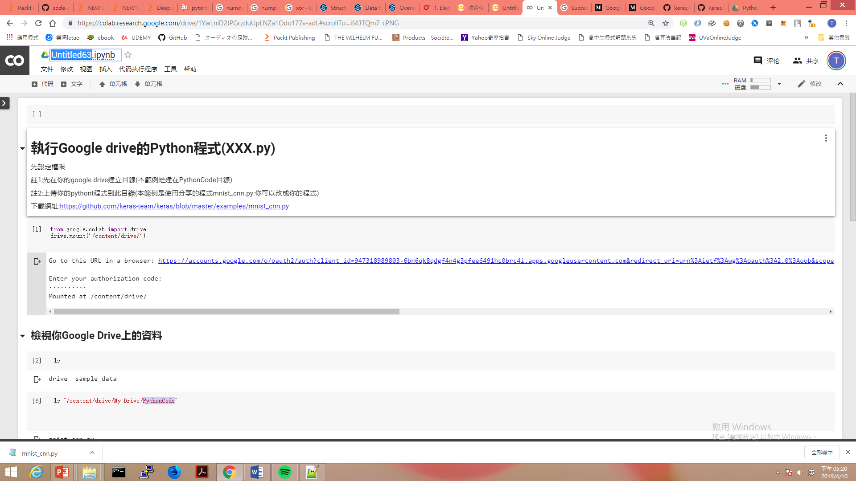
改名rename

Slide 40
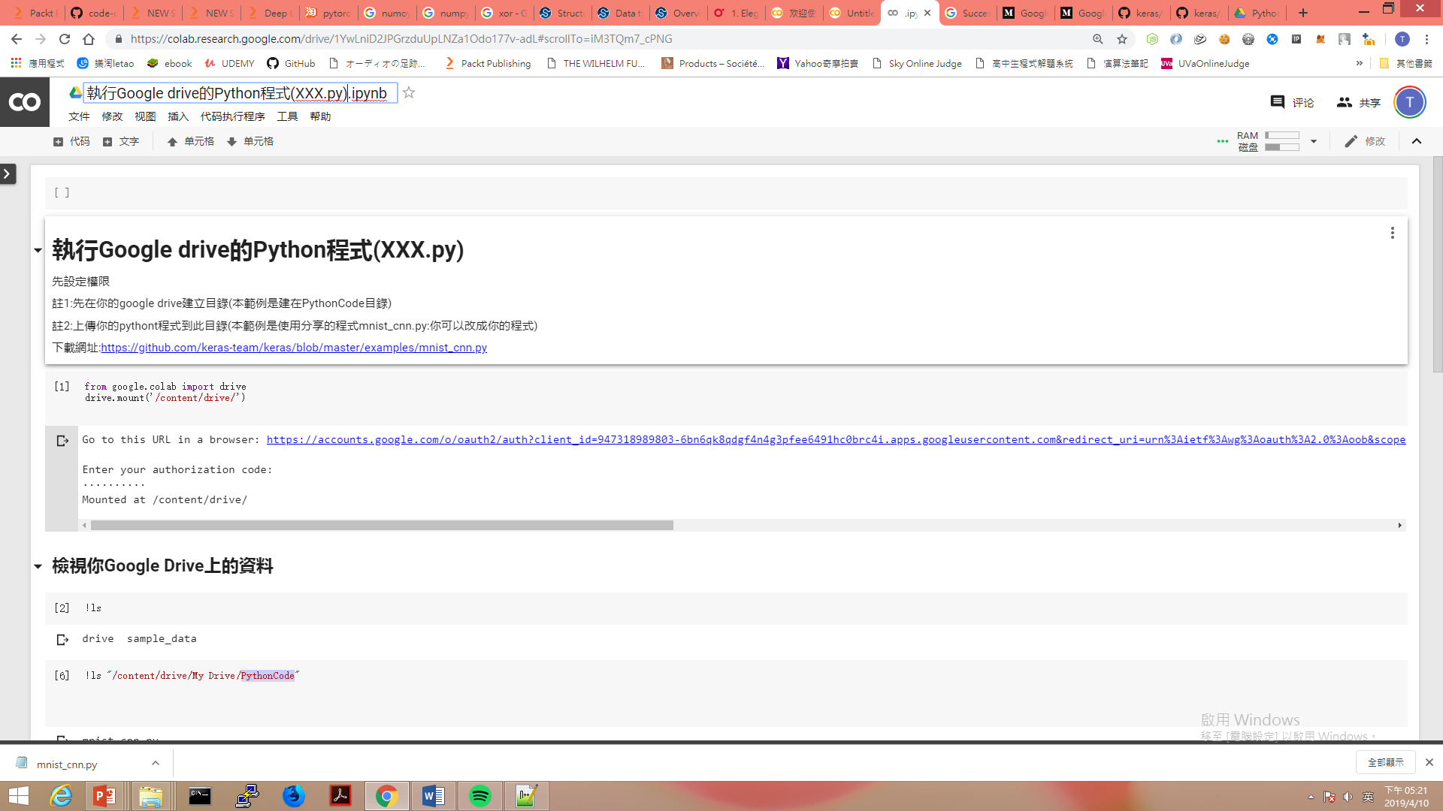
改名rename

Slide 41
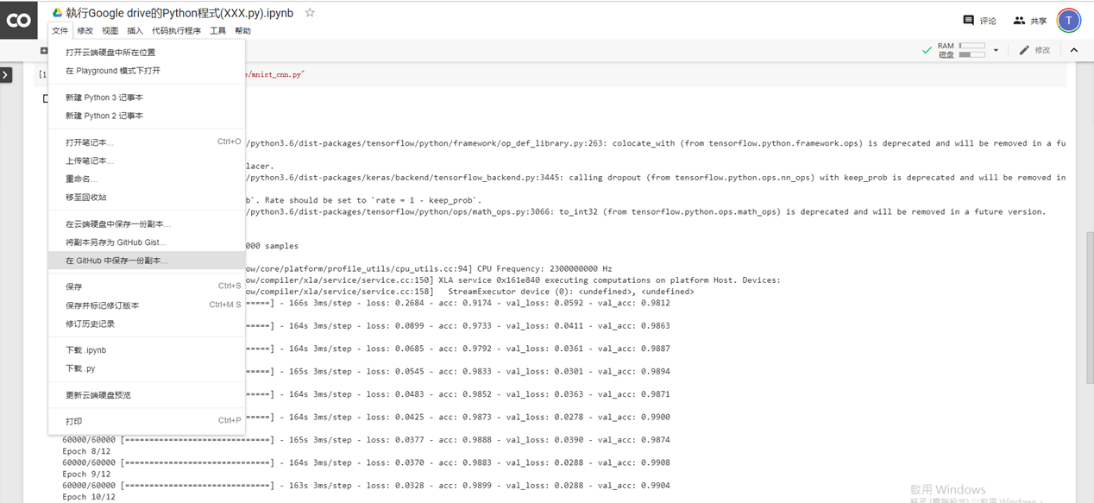
存到Github備份
點選

Slide 42
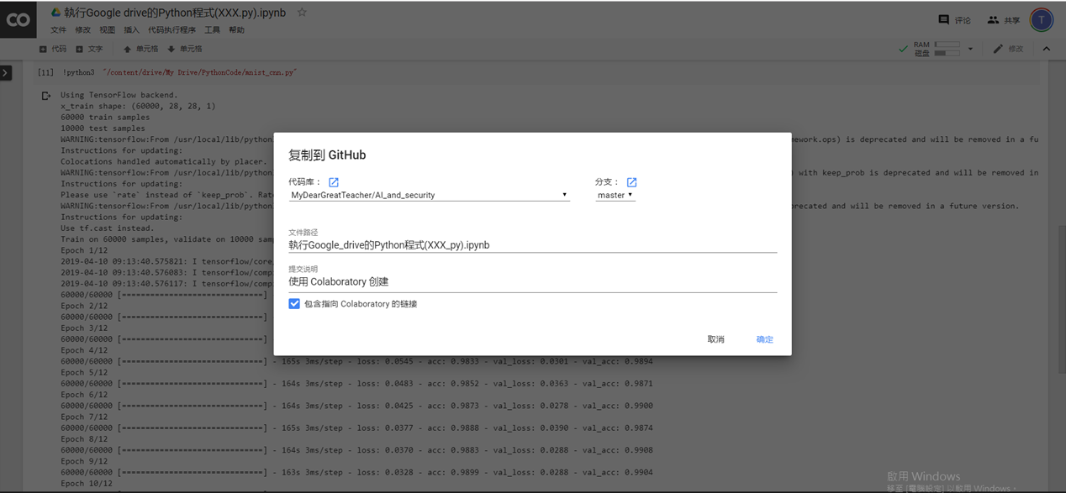
選擇存放到哪一個目錄底下
(1)選擇
(2)確定

Slide 43
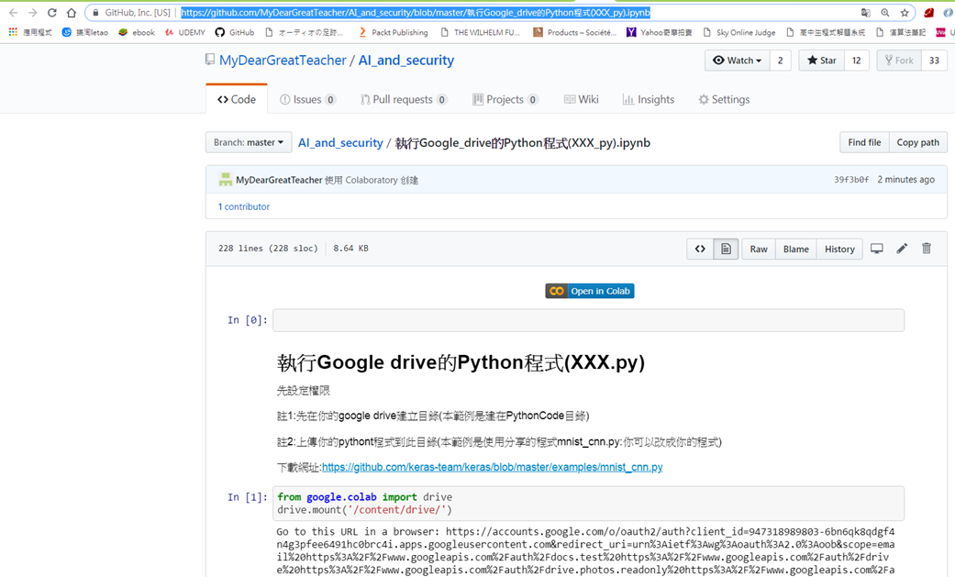
完成

Slide 44
NEXT
上傳你的pyhon程式並執行

Slide 45
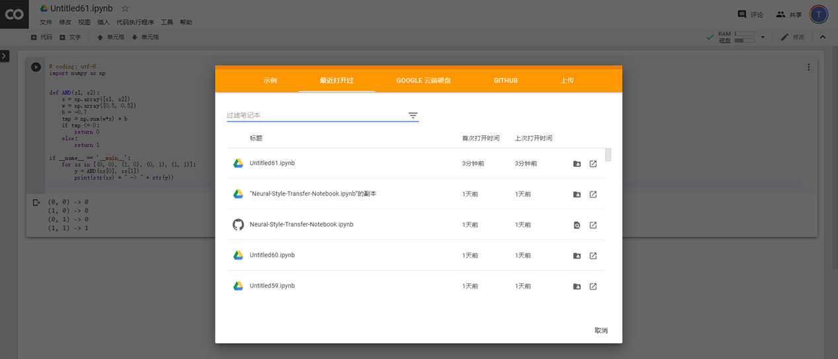

Slide 47
NEXT
安裝軟體

Slide 48
NEXT
Tensorboard in Google Colab

